Slide 1
I400 – Application Development in Java
Lecture 13

Slide 2
Today
Graphical User Interfaces
Dynamic GUI elements
ChoiceBox
ListView

Slide 3
Dynamic GUI Elements
Previous assumption:
We know the screen’s layout and controls beforehand
What if:
GUI elements have to be generated for different users
The screen has different layouts depending on previous user input
Example: A list populated based on user input
Today, we’ll use Java to generate dynamic GUI content for:
ChoiceBox / ComboBox
ListView

Slide 4
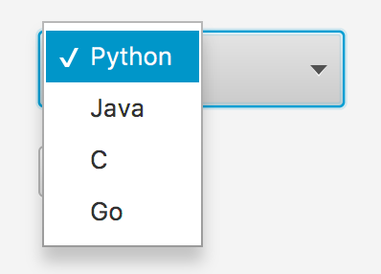

ChoiceBox
ChoiceBoxes allow our users to select from a list of choices.
Creating a ChoiceBox:
Use ChoiceBox<String> to tell which type of object/values will be populated in the choice box
Similar to arraylists

Slide 5
ChoiceBox / ComboBox
ChoiceBoxes allow our users to select from a list of choices.
ComboBoxes are similar to ChoiceBoxes, but they can contain all sorts of GUI material.
Choiceboxes are limited to text (Strings).

Slide 6
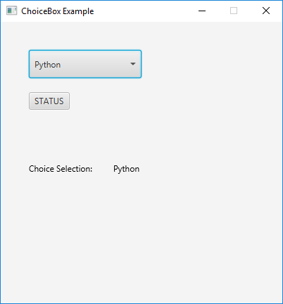
ChoiceBox Example
Follow along as we add code to provide functionality to an example ChoiceBox.
Start a new JavaFX project, then copy the code from Canvas into main.java

Slide 7
ChoiceBox (Steps)
Create a choice Box
Set Location of choice Box
Add Items to choice Box
Register a listener on choice Box for changes
Add Event Handling
Notes:
Refer back to how we used this syntax with arraylists to say what TYPE of object is going to be managed by the class.

Slide 8
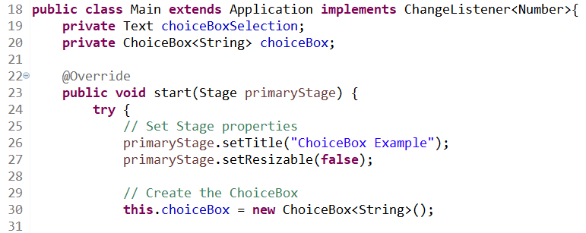
Starting with / Create Choice Box
Main.java
The Main class implements ChangeListener<Number> which we will use later to identify/register changes to our choice box
choiceBoxSelection (field that displays current selection) and choiceBox are class variables. This will be useful when we deal with ChangeListener
In override of the start method
Set title
Don’t allow stage to be resized
Create the choiceBox

Slide 9
ChoiceBox (Steps)
Create a choice Box
Set Location of choice Box
Add Items to choice Box
Register a listener on choice Box for changes
Add Event Handling
Notes:
Refer back to how we used this syntax with arraylists to say what TYPE of object is going to be managed by the class.

Slide 10
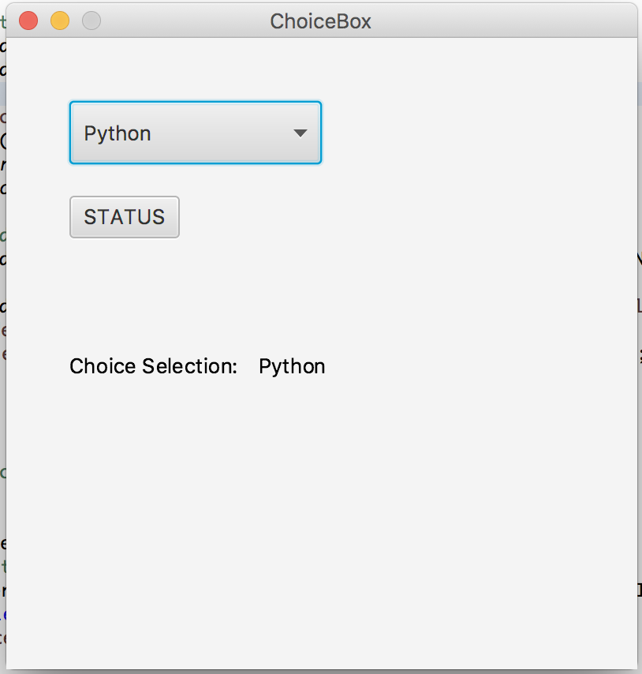
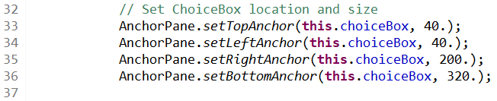
Location of ChoiceBox
Still in override of start method,
Specify the location of the choiceBox with respect to the AnchorPane embedded in the window pane.
The window pane is 400 x 400 (width, height).
40
200
40
Main.java
320

Slide 11
ChoiceBox (Steps)
Create a choice Box
Set Location of choice Box
Add Items to choice Box
Register a listener on choice Box for changes
Add Event Handling
Notes:
Refer back to how we used this syntax with arraylists to say what TYPE of object is going to be managed by the class.

Slide 12
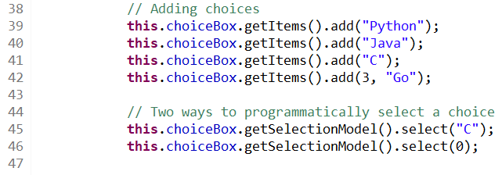
Add items to the choice box
Still in override of start method,
Add items to your choiceBox
Set the default choice by using item name or index value.
Main.java

Slide 13
ChoiceBox (Steps)
Create a choice Box
Set Location of choice Box
Add Items to choice Box
Register a listener on choice Box for changes
Add Event Handling
Notes:
Refer back to how we used this syntax with arraylists to say what TYPE of object is going to be managed by the class.

Slide 14
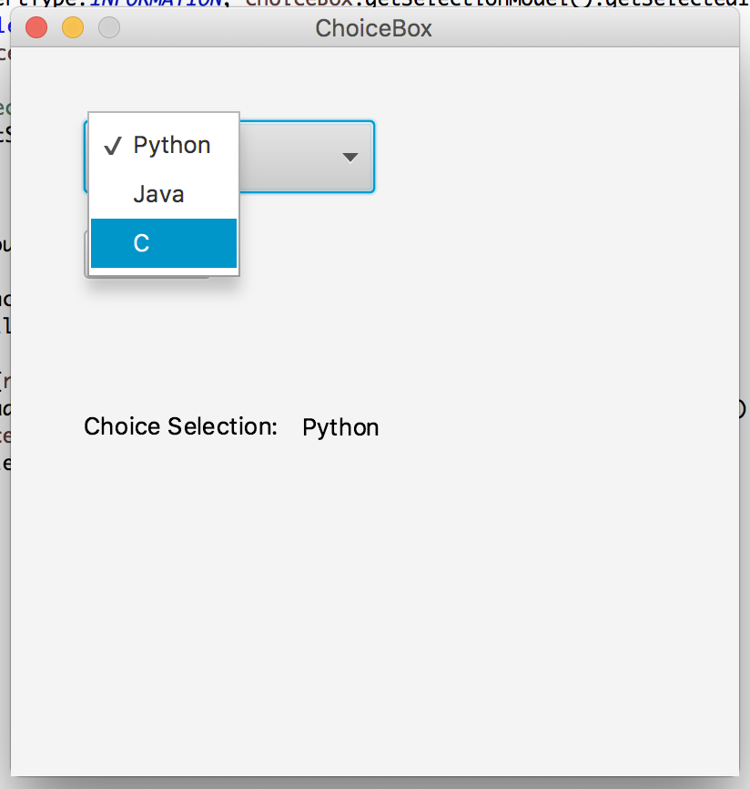
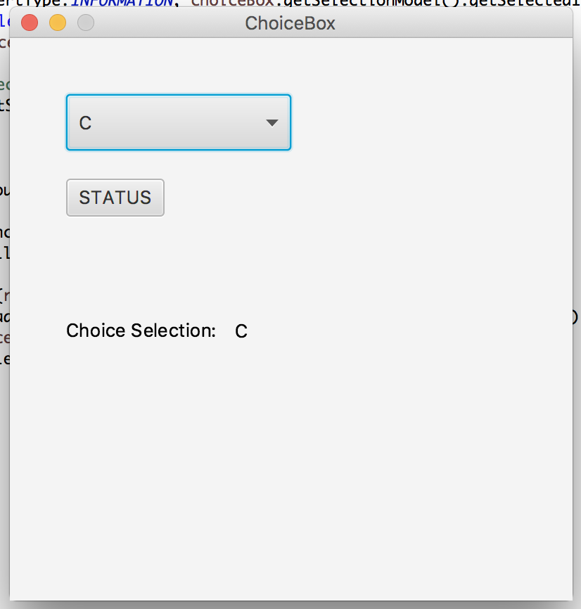
Change Listener … selection

Slide 15
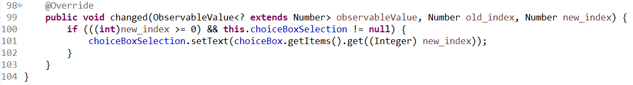
Create Listener on ChoiceBox
We need to create a “content change” listener method for our choiceBox.
Remember our main class implements ChangeListener
To generate the ChangeListener class override method changed in the main class, you can type the definition or allow Eclipse to do it for you.
Once you implement the ChangeListener class, Eclipse will show an error giving you an option to implement changed abstract method.
Main.java
Notes:
This slide needs work. What is between lines 64 and 97? Better to show code on left and comments to the right. If the code is too long, put in some line breaks so it can display on this slide better. Really can’t tell where this code resides… line 63 still in start method? Show the end of the start method. Lines 97-102 are at the highest level inside the class… right?

Slide 16
Create Listener on ChoiceBox
Using getItems() on choiceBox allows you to get a value from the current index value.
We declared choiceBox and choiceBoxSelection as class variables in order to access them in the changed method.
Main.java
Notes:
This slide needs work. What is between lines 64 and 97? Better to show code on left and comments to the right. If the code is too long, put in some line breaks so it can display on this slide better. Really can’t tell where this code resides… line 63 still in start method? Show the end of the start method. Lines 97-102 are at the highest level inside the class… right?

Slide 17
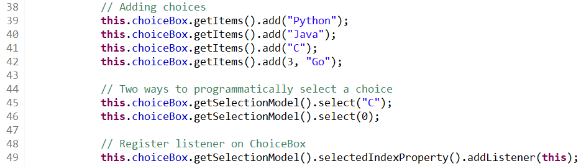
Register Listener on Choice Box
On the choiceBox, we define an event handler that registers “content change”
Remember our main class implements ChangeListener
The change method declared in previous slide will listen to changes registered to this class. We register the listener of choiceBox to this class.
Main.java
Notes:
This slide needs work. What is between lines 64 and 97? Better to show code on left and comments to the right. If the code is too long, put in some line breaks so it can display on this slide better. Really can’t tell where this code resides… line 63 still in start method? Show the end of the start method. Lines 97-102 are at the highest level inside the class… right?

Slide 18
ChoiceBox (Steps)
Create a choice Box
Set Location of choice Box
Add Items to choice Box
Register a listener on choice Box for changes
Add Event Handling
Notes:
Refer back to how we used this syntax with arraylists to say what TYPE of object is going to be managed by the class.

Slide 19
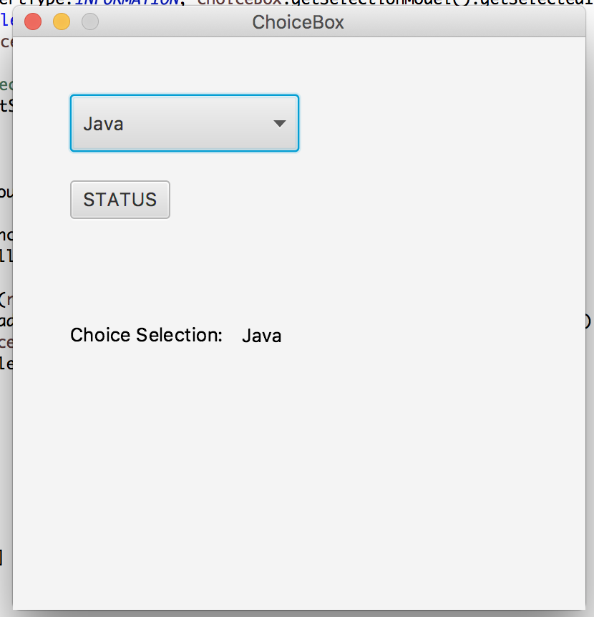
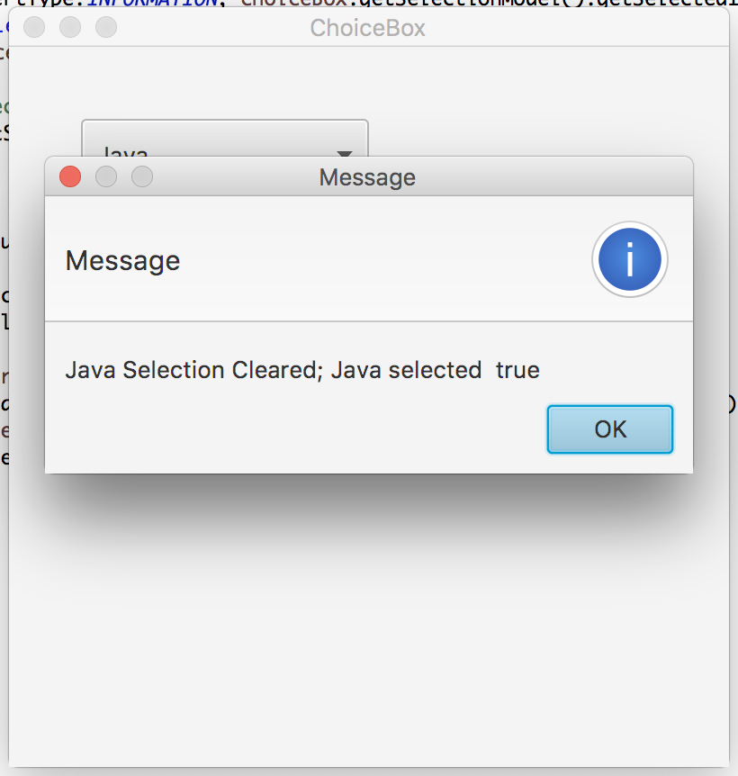
Event Handling … status/alert

Slide 20
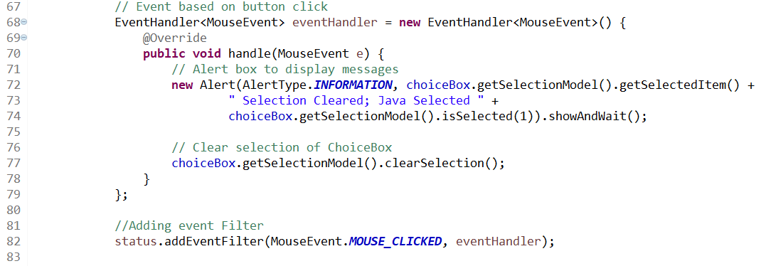
Event Handling
Generate an Alert message that tells the the current selection in comboBox and checks to see if item at index 1 was selected. Clears selection after closing the alert box.
Notice: The handle method is declared as a overridden function of the object EventHandler class.
Main.java

Slide 21
Problems?
If something went wrong or your code isn’t working, download a working version from Canvas as Main_full.java
Copy it over your code so you’re caught up.

Slide 22
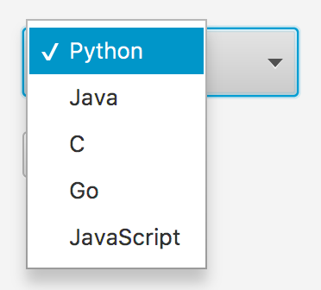
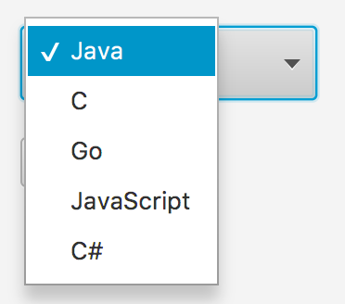
Top 5 (Group Work)
Create an application where you can populate the contents of choiceBox by adding items from a TextField. (Starter code: Main_Top5_Starter.java)
Your choiceBox should only contain a maximum of five entries. When the number of items would exceed five, delete the first item (item at index 0) so that only five items remain.
HINT: (four lines you’ll need, but not together!)
private TextField choiceBoxAdd;
this.choiceBoxAdd = new TextField();
choiceBoxAdd.getText();
choiceBox.getItems().remove(index);
Example:
Our Top 5 is “Programming Languages”
We want to add C# to the choiceBox list that already contains 5 languages.
Python (index 0) gets deleted and C# is added at the end

Slide 23
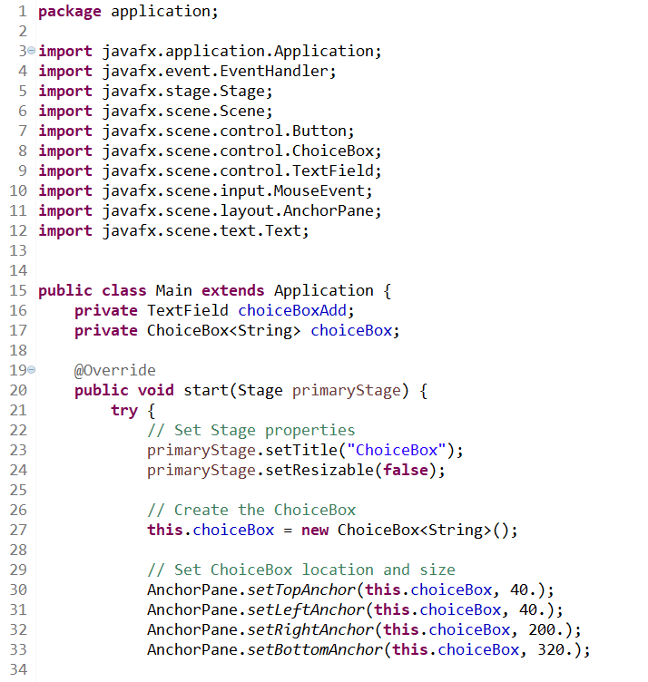
Top 5 (Solution pt 1)

Slide 24
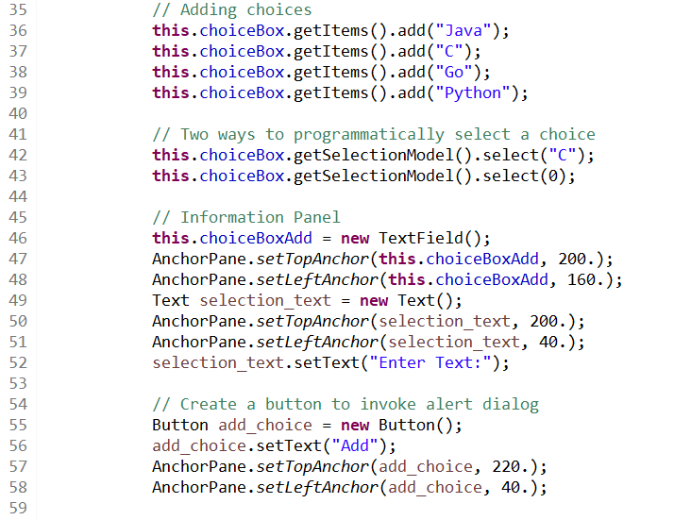
Top 5 (Solution pt 2)

Slide 25
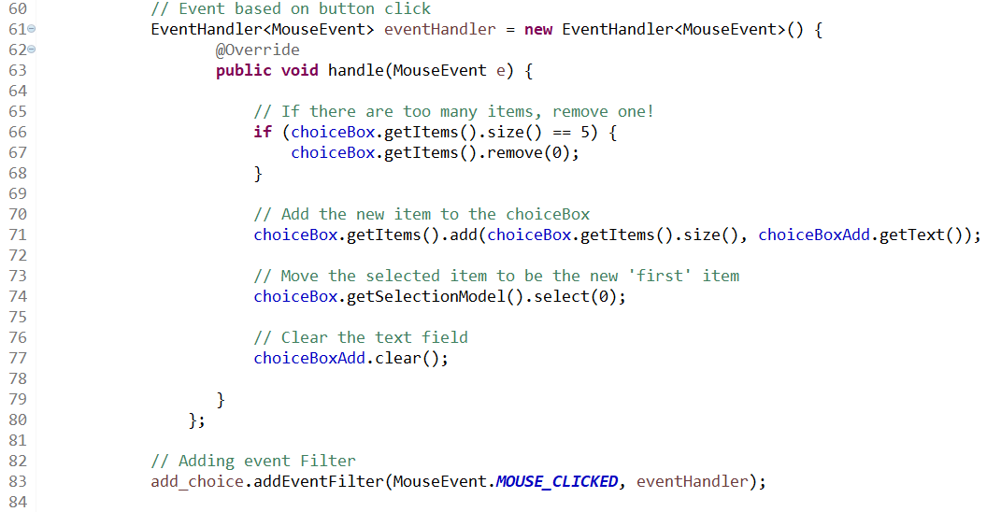
Top 5 (Solution pt 3)

Slide 26
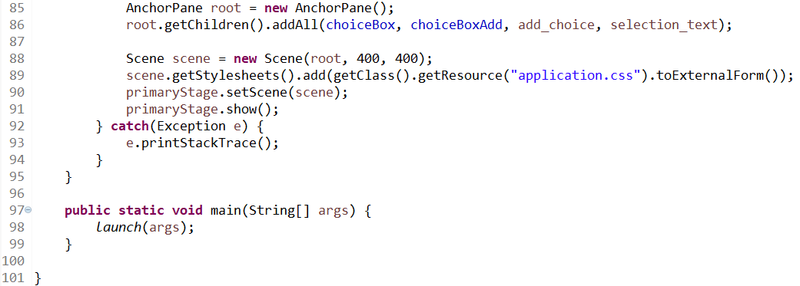
Top 5 (Solution pt 4)

Slide 27
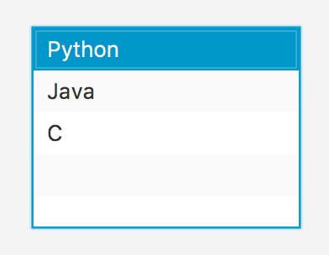
ListView
Allows a list of items to be displayed
Convenient for when the user should be able to see all available options

Slide 28
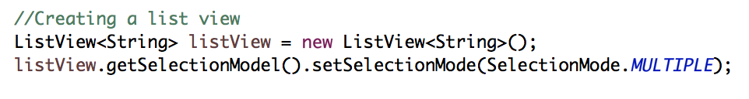
ListView
Creating a ListView
Use ListView<String> to tell which type of object/values will be displayed, similar to ChoiceBox
Implementing a ListView in Java is essentially the same as a ChoiceBox, but you can select multiple items!

Slide 29
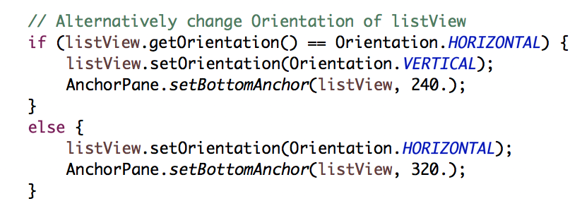
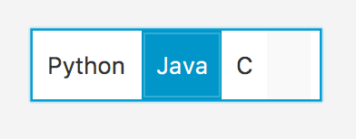
ListView Orientation Types
ListViews can have horizontal or vertical orientations.
This code will alternate between the two possible orientations of the ListView.
BottomAnchor is redefined to have a consistent size.

Slide 30
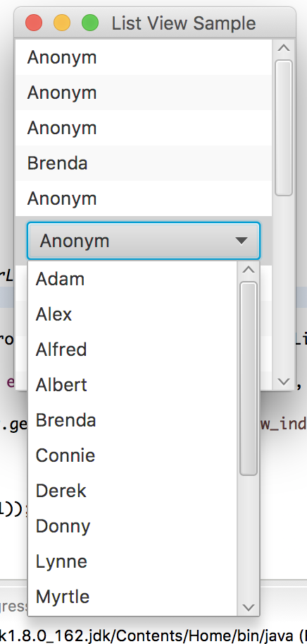
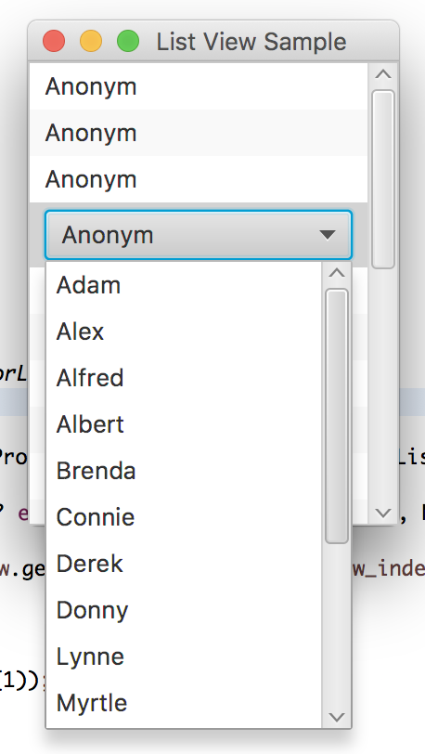
Advanced ListViews
You can also have a ListView where each item of this view is a ChoiceBox
The limitation of this is that the ChoiceBox for each ListView item will have the same list

Slide 31
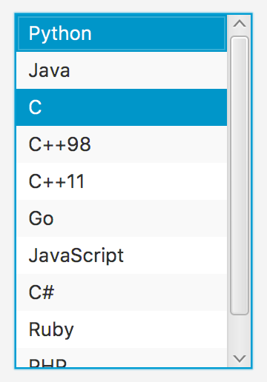
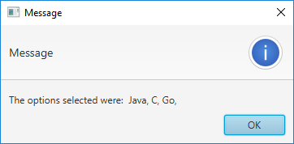
Language List (Group Work)
Create an application where you can populate the contents of the ListView by adding items from a TextField. (Starter code: Main_LV_Starter.java)
With your TextField, allow the user to enter an item.
If the item is not present in the ListView, add it.
If the item is already found in the ListView then delete the item from the ListView instead of adding it again.
Once that’s done, display all items selected in the ListView when the button is clicked in a new Alert box.
<listView>.getSelectionModel().getSelectedItems() will return an arrayList of all items selected
Convert this to a String and show it to the user

Slide 32
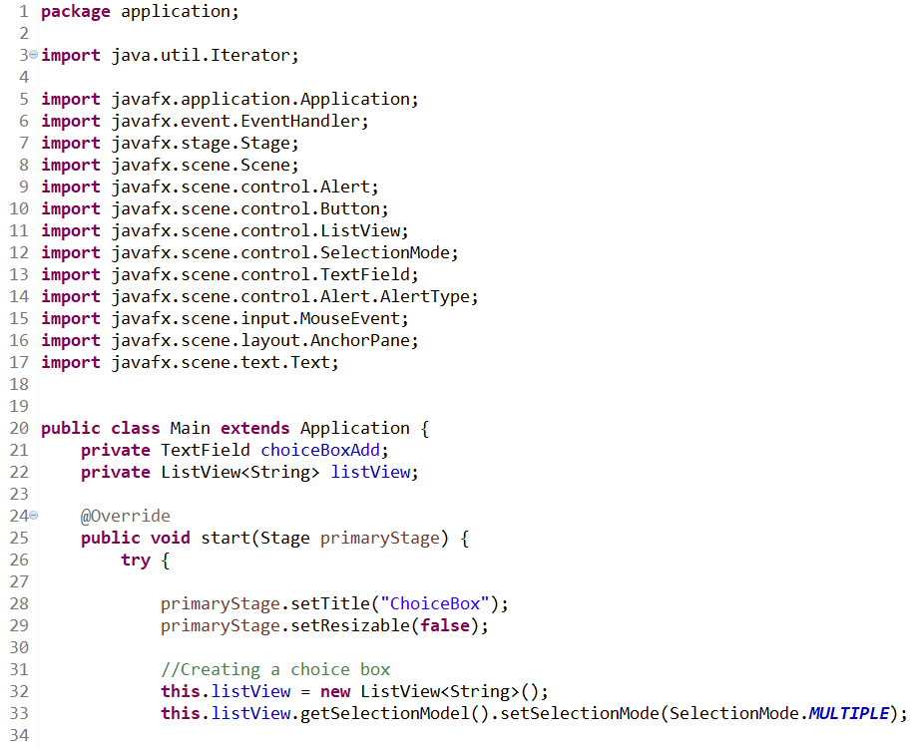
Language List (Solution pt 1)

Slide 33
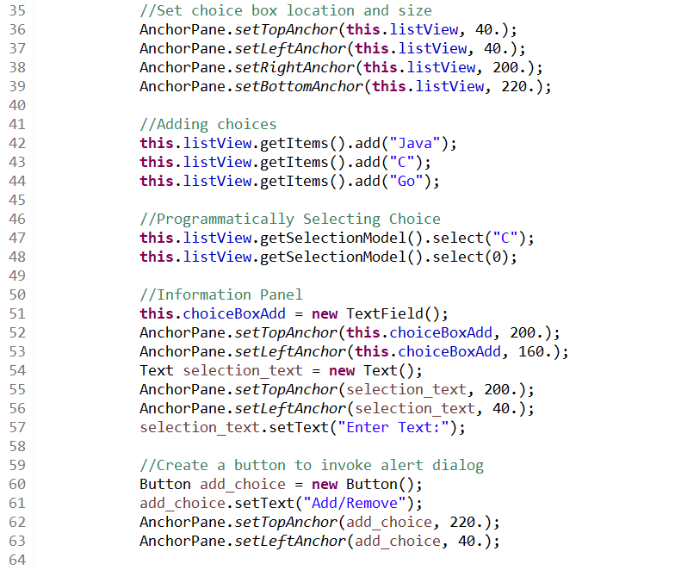
Language List (Solution pt 2)

Slide 34
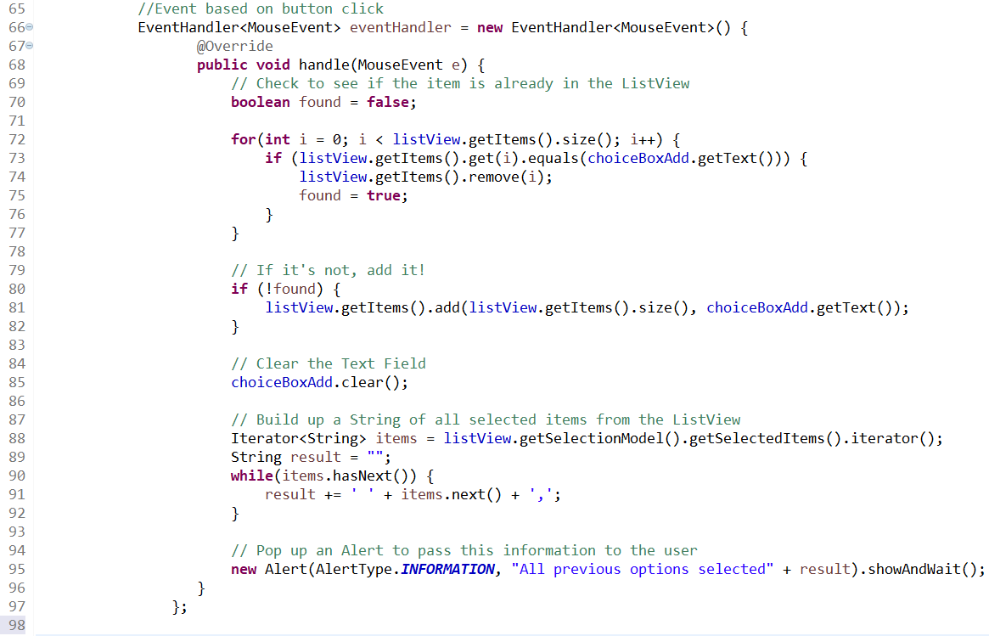
Language List (Solution pt 3, V1)

Slide 35
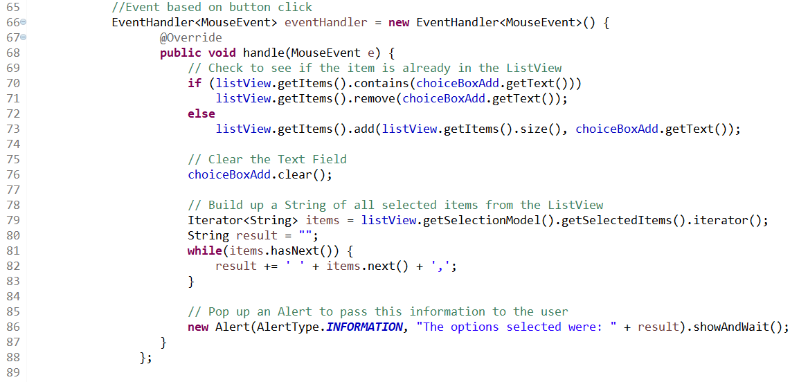
Language List (Solution pt 3, V2)

Slide 36
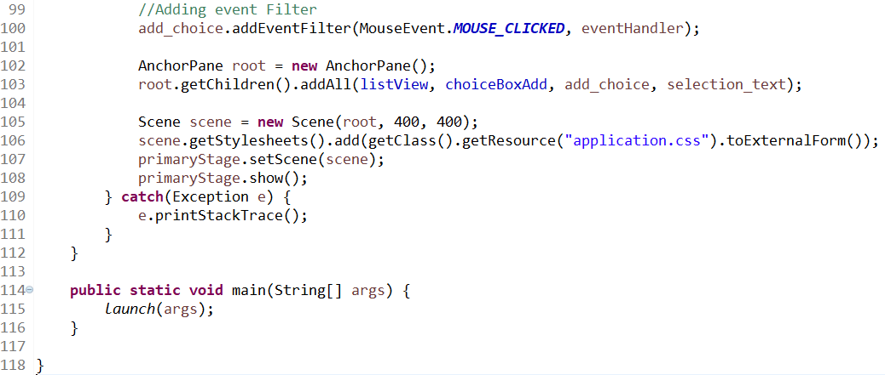
Language List (Solution pt 4)

Slide 37
Questions?

